Slide 1
Implicit Differentiation and Rational Powers
Section 3.7
Spring 2017 Haitham S. Solh ©

Slide 2
Implicit Differentiation
Up to this point, we have been differentiating functions defined explicitly in terms of an independent variable (such as y as a function of x).
But what if y was not expressed as a function of x, and it is impossible or difficult/cumbersome to do so?
In this case, we can obtain the derivative with respect to y (dy/dx) by using a process called implicit differentiation.

Slide 3
Implicit Differentiation
Example 1: The equation of a circle C with center O (0,0) and radius 1 is: x² + y² = 1. y is then either √1 – x² or –√ 1 – x² .
Differentiating both sides of the equation, we get:

Slide 4
Implicit Differentiation
Example 2: Assume that y is a differentiable function of x that satisfies the given equation. Use implicit differentiation to express dy/dx in terms of x and y.
a) 2x²y – y³ + 1 = x + 2y

Slide 5
Implicit Differentiation
a) 2x²y – y³ + 1 = x + 2y
Note: We CANNOT simplify this any further.

Slide 6
Implicit Differentiation
b) cos (x – y) = (2x+1)³·y

Slide 7
Implicit Differentiation
c) y = (4+x²)^{⅓} satisfies the equation y³ – x² = 4. Use implicit differentiation to express d²y/dx² in terms of x and y.
Solution: Differentiating with respect to x gives:
Differentiating again, we obtain:

Slide 8
Implicit Differentiation
Hence:
But we already found that:

Slide 9
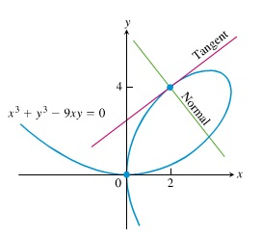
Applications
Tangents to a curve

Slide 10
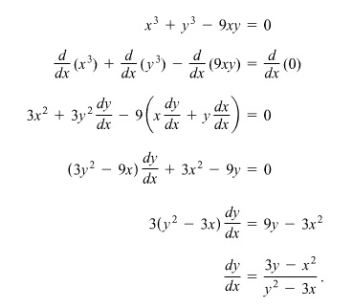
Applications
Tangents to a curve

Slide 11
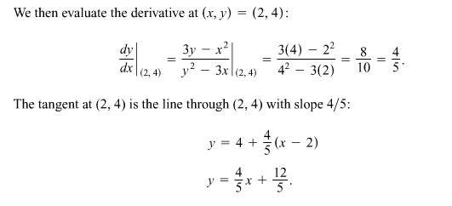
Applications
Tangents to a curve

